Slide 1
Scheduler
Operating System
Prepared By:
Hamza Mehmood
Jibran Naeem
Saad Rehman
Anique Khadim

Slide 2
Outline
Scheduler
Long-Term Scheduler
Short-Term Scheduler
Medium-Term Scheduler
Comparison among Scheduler

Slide 3
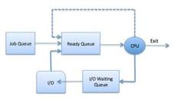
WHAT IS Scheduler?
The OS scheduler determines how to move processes between the ready and run queues which can only have one entry per processor core on the system; in the above diagram, it has been merged with the CPU.

Slide 4
Scheduler and its terms
Schedulers are special system software which handle process scheduling in various ways. Their main task is to select the jobs to be submitted into the system and to decide which process to run. Schedulers are of three types:
Long-Term Scheduler
Short-Term Scheduler
Medium-Term Scheduler

Slide 5
Long-Term Scheduler
It is also called a job scheduler. A long-term scheduler determines which programs are admitted to the system for processing. It selects processes from the queue and loads them into memory for execution. Process loads into the memory for CPU scheduling.
The primary objective of the job scheduler is to provide a balanced mix of jobs, such as I/O bound and processor bound. It also controls the degree of multiprogramming. If the degree of multiprogramming is stable, then the average rate of process creation must be equal to the average departure rate of processes leaving the system.
On some systems, the long-term scheduler may not be available or minimal. Time-sharing operating systems have no long term scheduler. When a process changes the state from new to ready, then there is use of long-term scheduler.

Slide 6
Short Term Scheduler
It is also called as CPU scheduler. Its main objective is to increase system performance in accordance with the chosen set of criteria. It is the change of ready state to running state of the process. CPU scheduler selects a process among the processes that are ready to execute and allocates CPU to one of them.
Short-term schedulers, also known as dispatchers, make the decision of which process to execute next. Short-term schedulers are faster than long-term schedulers.

Slide 7
Medium Term Scheduler
Medium-term scheduling is a part of swapping. It removes the processes from the memory. It reduces the degree of multiprogramming. The medium-term scheduler is in-charge of handling the swapped out-processes.
A running process may become suspended if it makes an I/O request. A suspended processes cannot make any progress towards completion. In this condition, to remove the process from memory and make space for other processes, the suspended process is moved to the secondary storage. This process is called swapping, and the process is said to be swapped out or rolled out. Swapping may be necessary to improve the process mix.

Slide 8
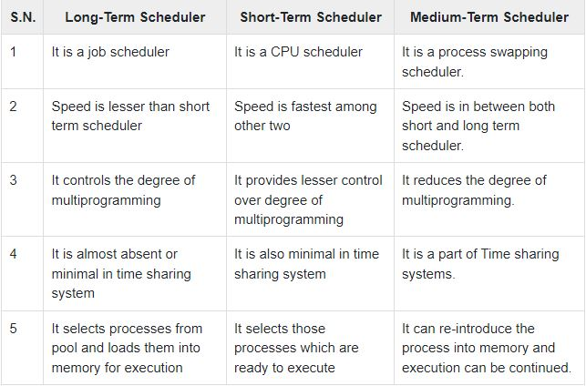
Comparison among Scheduler

Slide 9
Thank you

